Slide 1
ER Diagram

Slide 2
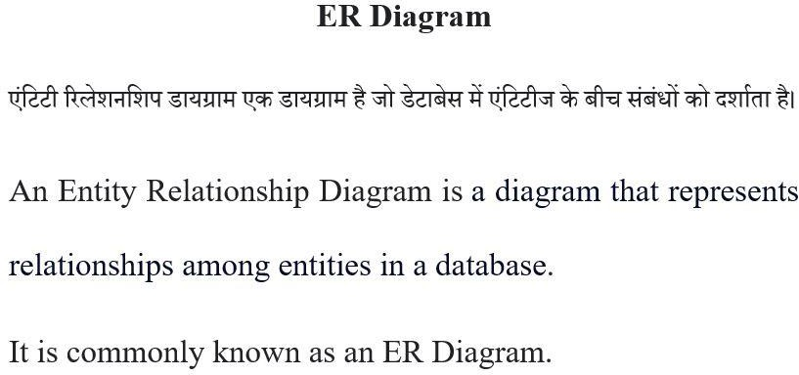
Peter Chen proposed ER Diagrams in 1971 to create a uniform convention that can be used as a conceptual modelling tool.
The first ER model paper was published in1976.

Slide 3


Slide 4
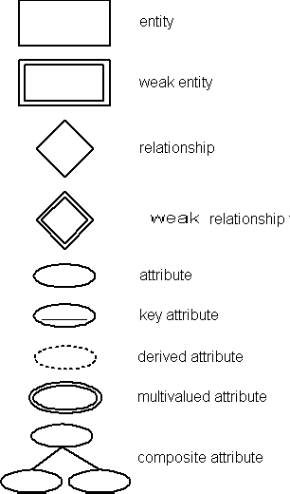

Slide 5
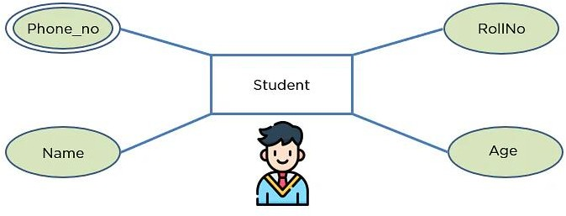
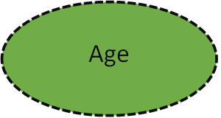

Slide 6
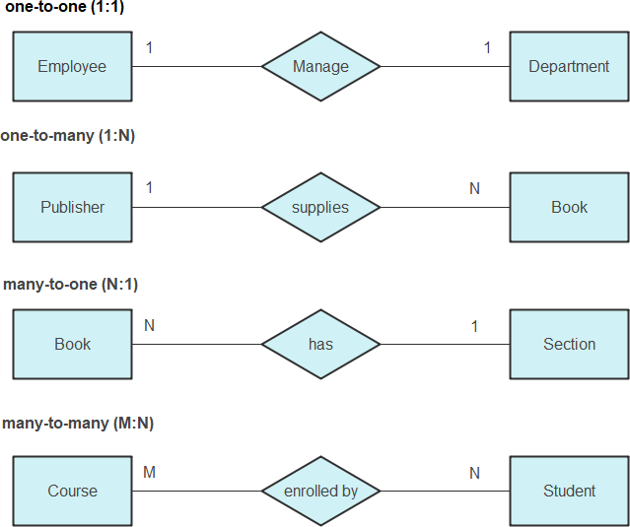

Slide 7
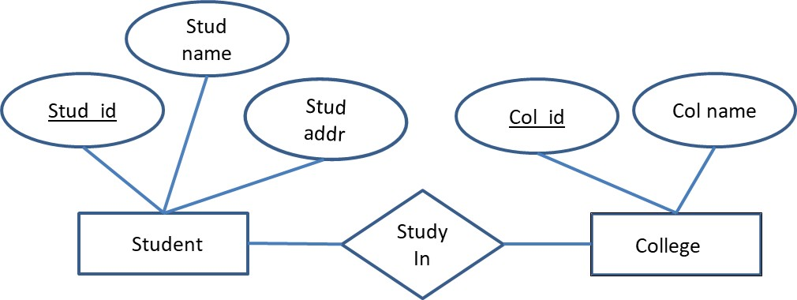

Slide 8
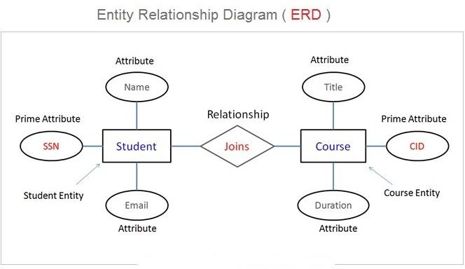

Slide 9
